Slide 1

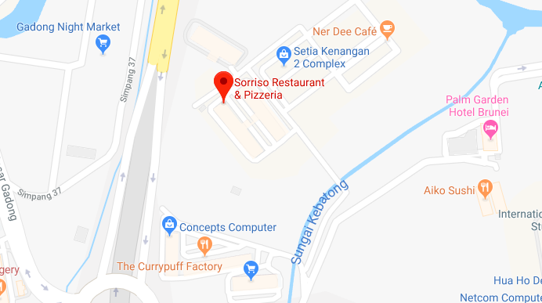








- 1 HR +
Starts
1:20PM
Ends Today
2:20PM
$ $1.00
Select Parking Lot Location
Select Vehicle
Select Card
PROCEED
Notes:
Make map bigger? Or move everthing down?

Slide 2

SELECT CAR PARK
Search Car Park
Nearest Car Park
Name of of car park
Name of of car park
Name of of car park
Name of of car park
Name of of car park
Name of of car park
All Car Parks
Name of of car park
Name of of car park
Name of of car park
Name of of car park
Name of of car park
Name of of car park

Slide 3



ADD VEHICLE
Enter Vehicle Registration Number
Car
Truck
Motorcycle
SAVED VEHICLE(S)
KK 3605
BN 4490
ADD VEHICLE
Notes:
- Add vehicle will change color once vehicle registration number is added to the same as the “proceed” on home page

Slide 4
ADD CARD
Name on card
As it appears on your credit card
Card Number
0000 0000 0000 0000
Card Number (month – year)
mm
yyyy
CVC/ CCV Code
***
SAVED CARD(S)
0000 0000 0000 9921
ADD CARD
Notes:
- Add Card will change color once Correct card is input.

Slide 5
CONFIRM DETAILS
DURATION
1 HR
Starts
1:20PM
Ends Today
2:20PM
$ $1.00
Reagent Square, Spg 150, Block B, Kiulap
KK 3605
**** **** **** 9921
START PARKING

Slide 6
HISTORY
Sessions
Bills
Recent Activity
JAN
10
Baiduri Bank, BSB 1:20pm – 2.20pm
JAN
9
Jolibee, BSB 5:20pm – 6:20pm
JAN
1
Central Hotel, BSB 8:00pm – 8:20pm
JAN
10
Baiduri Bank, BSB 1:20pm – 2.20pm
JAN
9
Jolibee, BSB 5:20pm – 6:20pm
JAN
1
Central Hotel, BSB 8:00pm – 8:20pm

Slide 7
HISTORY
Sessions
Bills
Payment History
JAN
10
Baiduri Bank, BSB 1:20pm – 2.20pm
$1.00
JAN
9
Jolibee, BSB 5:20pm – 6:20pm
$2.00
JAN
1
Central Hotel, BSB 8:00pm – 8:20pm
$0.50

